Slide 1
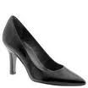
Product: Ladies Shoes
2 x 120 € = 240 €
Notes:
Low heel and cushioned interior for comfort and style in simple yet elegant shoes

Slide 2
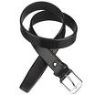
Product: Belt
2 x 30 € = 60 €
Notes:
Leather belt

Slide 3
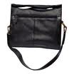
Product: Bag
4 x 125 € = 500 €
Notes:
Unisex bag suitable for carrying laptops with room for many additional items

Slide 4
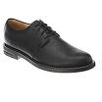
Product: Mens Shoes
2 x 110 € = 220 €
Notes:
Leather upper and lower lace up shoes

Slide 5
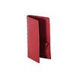
Product: Wallet
2 x 50 € = 100 €
Notes:
Travel wallet suitable for men and women. Several compartments for credit cards, passports and cash

Slide 6
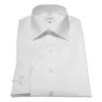
Product: Business Shirt
3 x 50 € = 150 €
Notes:
Wrinkle-free cotton business shirt

Slide 7
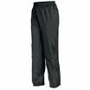
Product: Trousers
3 x 80 € = 240 €
Notes:
Black trousers suitable for every business man

Slide 8
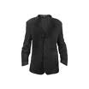
Product: Jacket
3 x 150 € = 450 €
Notes:
Fully lined jacket which is both professional and extremely comfortable to wear

Slide 9
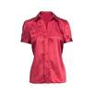
Product: Blouse
3 x 60 € = 180 €
Notes:
Silk blouse ideal for all business women

Slide 10
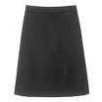
Product: Skirt
3 x 80 € = 240 €
Notes:
Wrinkle free skirt

