Slide 1
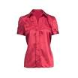
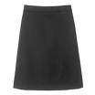
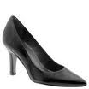
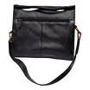
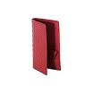
Product: Blouse
4 x 60 € = 240 €
Silk blouse ideal for all business women

Slide 2
Product: Blouse
Only
60

Slide 3
Product: Skirt
4 x 80 € = 320 €
Wrinkle free skirt

Slide 4
Product: Skirt
Only
80

Slide 5
Product: Ladies Shoes
4 x 120 € = 480 €
Low heel and cushioned interior for comfort and style in simple yet elegant shoes

Slide 6
Product: Ladies Shoes
Only
120

Slide 7
Product: Bag
4 x 125 € = 500 €
Unisex bag suitable for carrying laptops with room for many additional items

Slide 8
Product: Bag
Only
125

Slide 9
Product: Wallet
2 x 50 € = 100 €
Travel wallet suitable for men and women. Several compartments for credit cards, passports and cash

Slide 10
Product: Wallet
Only
50

